Slide 1

Ehsan Hosseinzadeh Shah Newaz
Restaurant Review Word Association &
Recommender System
by
Notes:
Ehsan and shah

Slide 2


Overview
- The Problem
- Research Methods
- Demo
- Conclusion
- Q&A
Notes:
Shah

Slide 3
The Problem
- Businesses and restaurants need a reasonable amount of sales in order to
remain active and relevant.
- Low sales rate means that businesses have a higher chance of failing.
- What are the strategies that the average businesses can apply in order to
promote efficiently and create a successful business?
Notes:
Shah

Slide 4

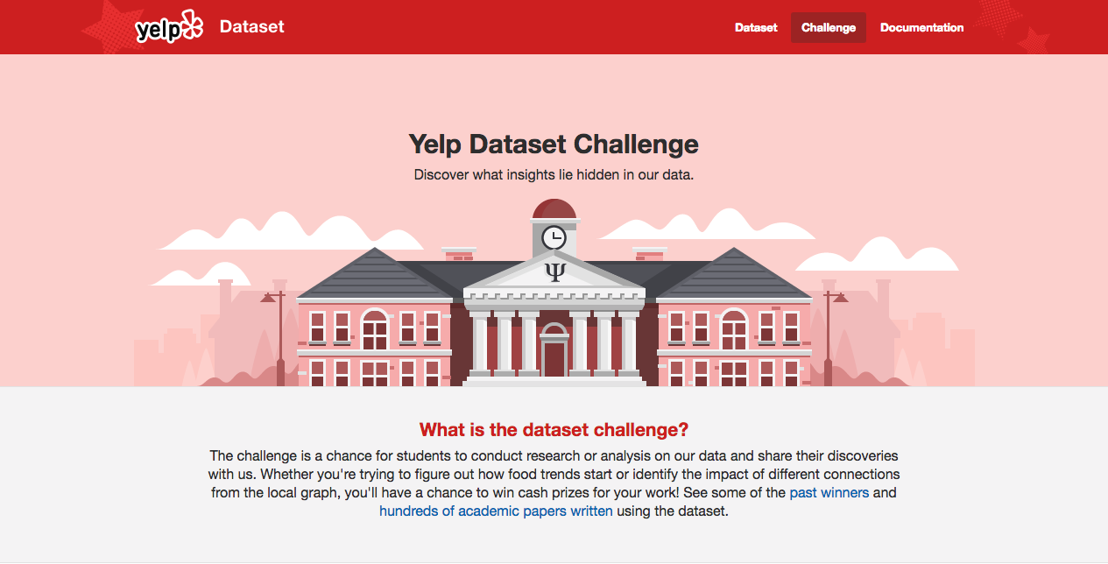
Research Methods
Dataset:
Yelp Dataset Challenge Round 11
The dataset contains information about local businesses in 11 metropolitan areas across 4 countries.
- Data Mining Techniques:
- Association Rules:
- Apriori Algorithm
- Recommendation System:
- Simple Recommenders
Notes:
Shah

Slide 5
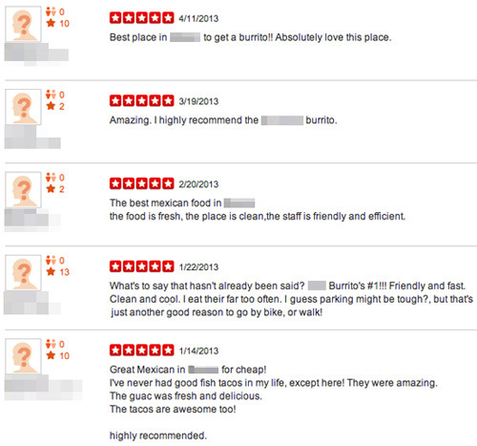
Association
- Association is a data mining technique that discovers the
probability of the co-occurrence of items in a collection.
The relationships between co-occurring items are
expressed as association rules.
We are trying to find the meaningful relationships between the words from different user reviews using Apriori.
- We applied Apriori using ‘mlxtend’ implementation.
Notes:
Ehsan

Slide 6
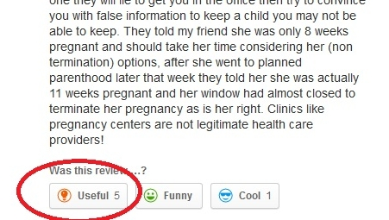
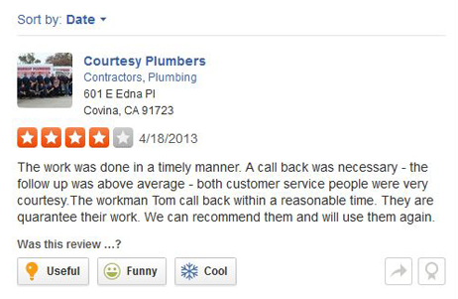
Recommendation System
Recommendation system is a data-mining technique that will use a predefined algorithm to suggest results that you might be in favor of.
- Simple Recommender:
Weighted Rating (WR):
- WR = ( V / ( V + M) * R) + ( M / ( M + V ) * C )
Where:
- V is the ‘stars’ value for each record
- C is the mean/average rate of ‘stars’
- M is the ’useful’ rate, received by the user in the 90th
percentile
- R is the ‘useful’ value for each record
Notes:
Ehsan

Slide 7
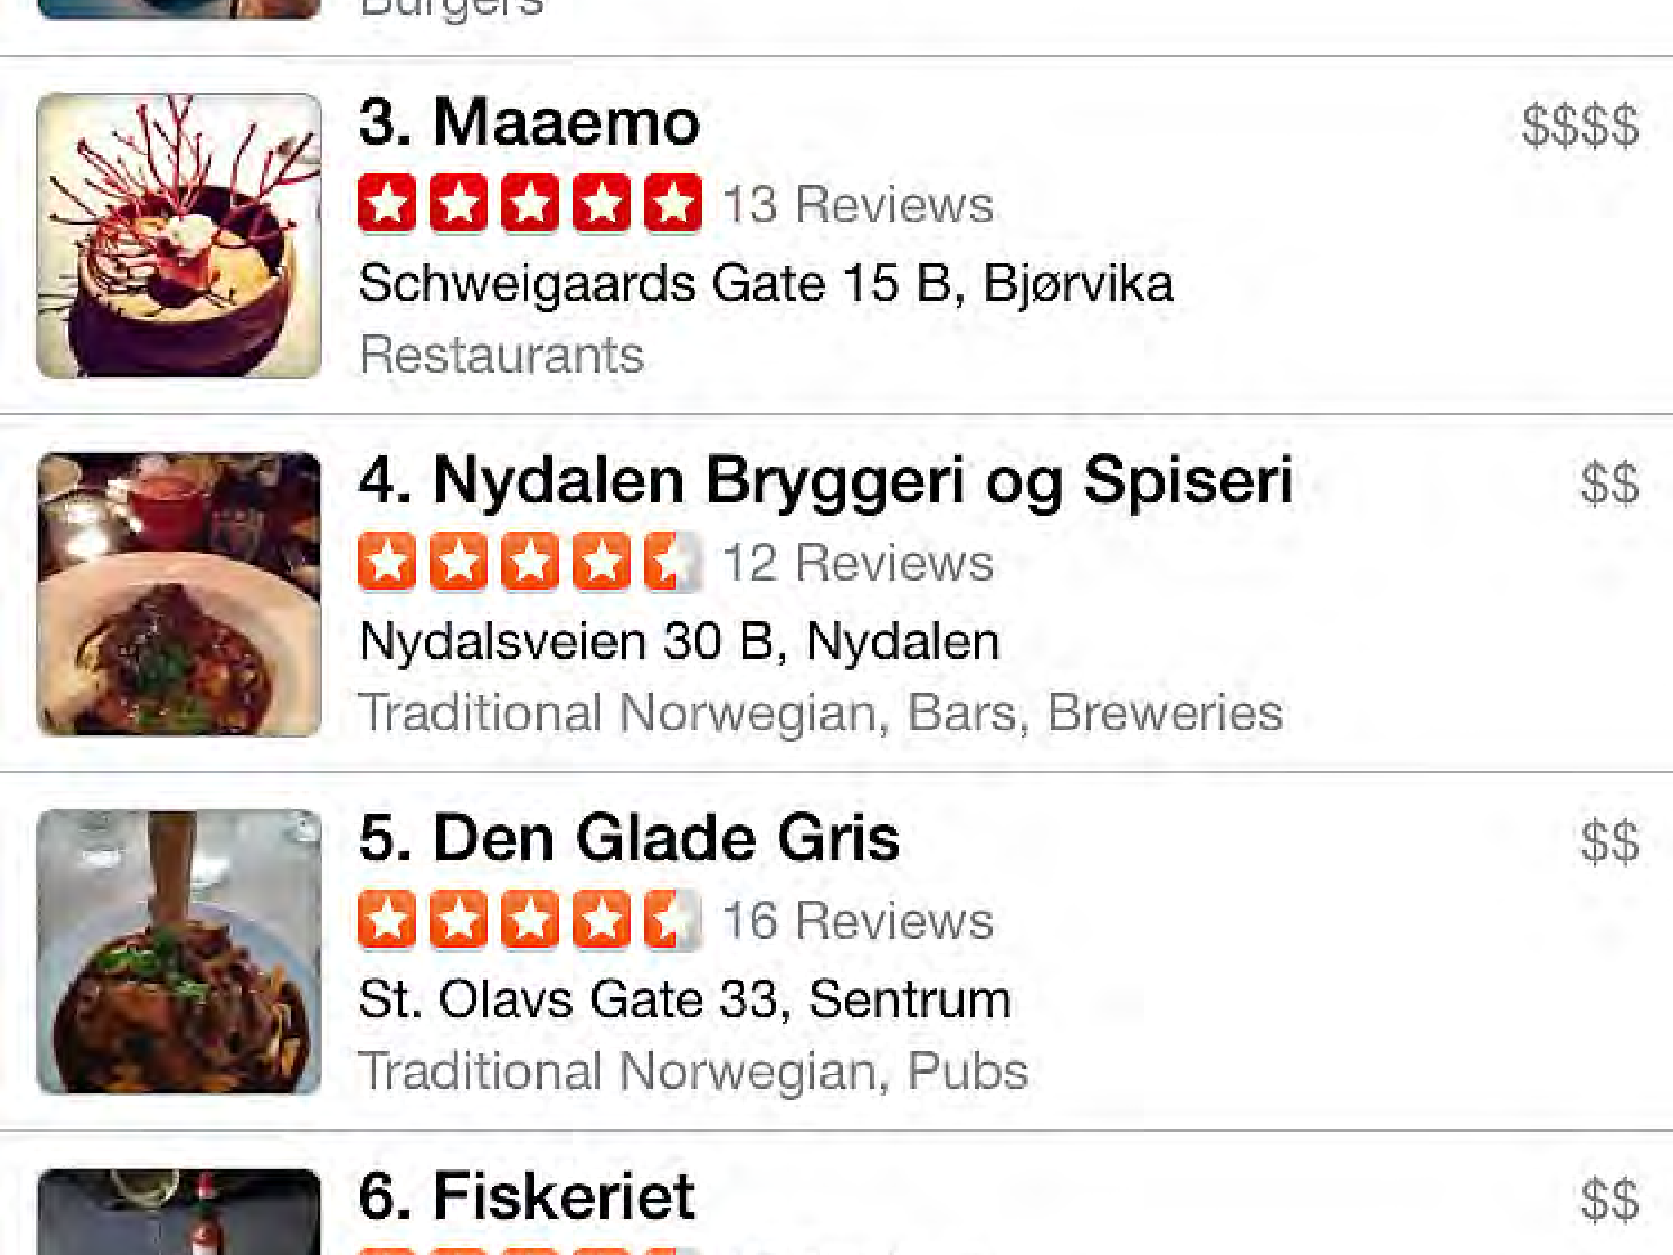

1. Association 2. Recommendation System
Demo
Notes:
Ehsan Association and Shah Recommendation

Slide 8
Conclusion
Association
Recommendation
Final Conclusion
Businesses can look at our results and see the meaningful responses from the customers and use those rules to apply in future Machine Learning models
Businesses can use the top 5 recommended restaurants & businesses that we found and compare with their own businesses
Touristy areas generally get a high amount of yelp feedbacks regardless and are generally successful.
“LOCATION, LOCATION. LOCATION”
Notes:
Ehsan Association and shah Recommendation and Final Conclusion

Slide 9

Question & Answer

Slide 10

Thank You

